Slide 1


Slide 2
Cassandra goals for the day !!!!!!!
How data is represented ?
How data is stored ?
How data is Read and Written ?
How to model data in Cassandra ?
Pitfalls
Execute Queries in Cassandra.

Slide 3
What is Cassandra ?
NoSQL Database
Column Oriented
Decentralized Architecture
Elastically Scalable
Tunable Consistency
High Availability
Very Fast Writes
N1
Cassandara
N2
N4
N3

Slide 4
Data Representation
Keyspace
Library Catalog
Column family
Book
Column
book_id
book_name
book_type

Slide 5
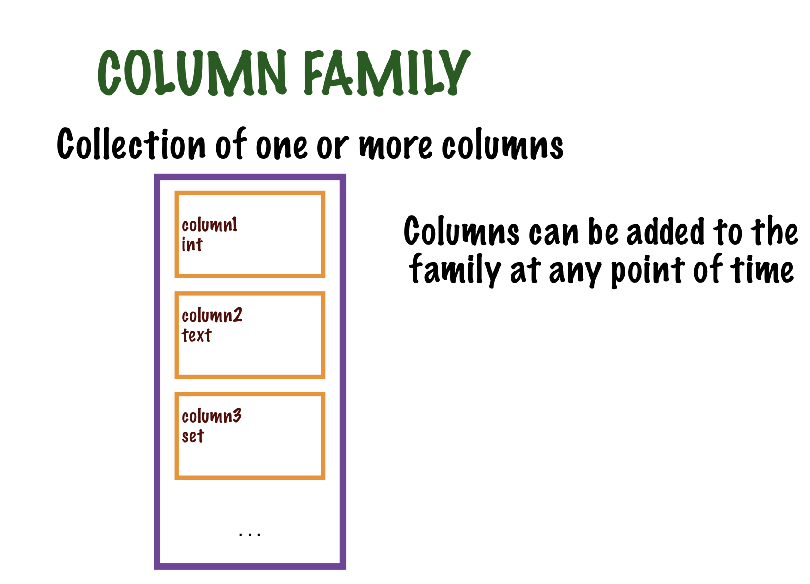

Slide 6
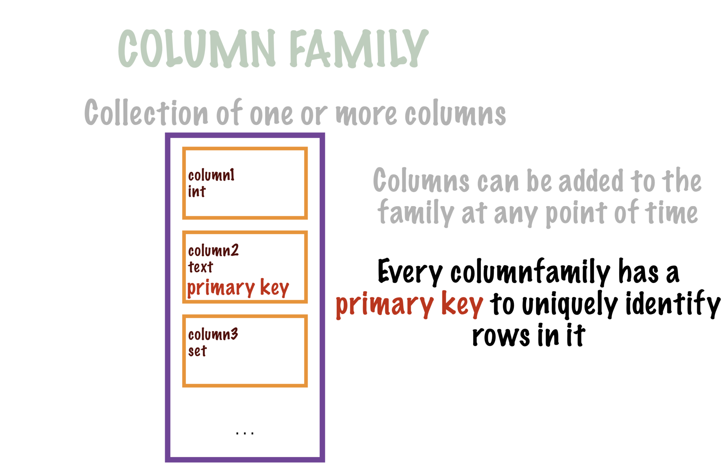

Slide 7
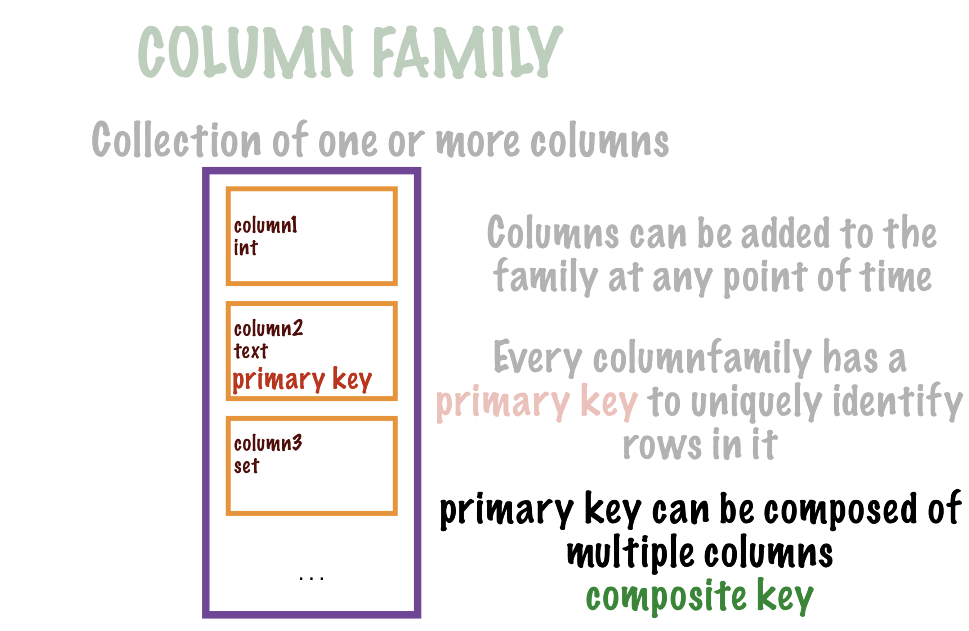

Slide 8
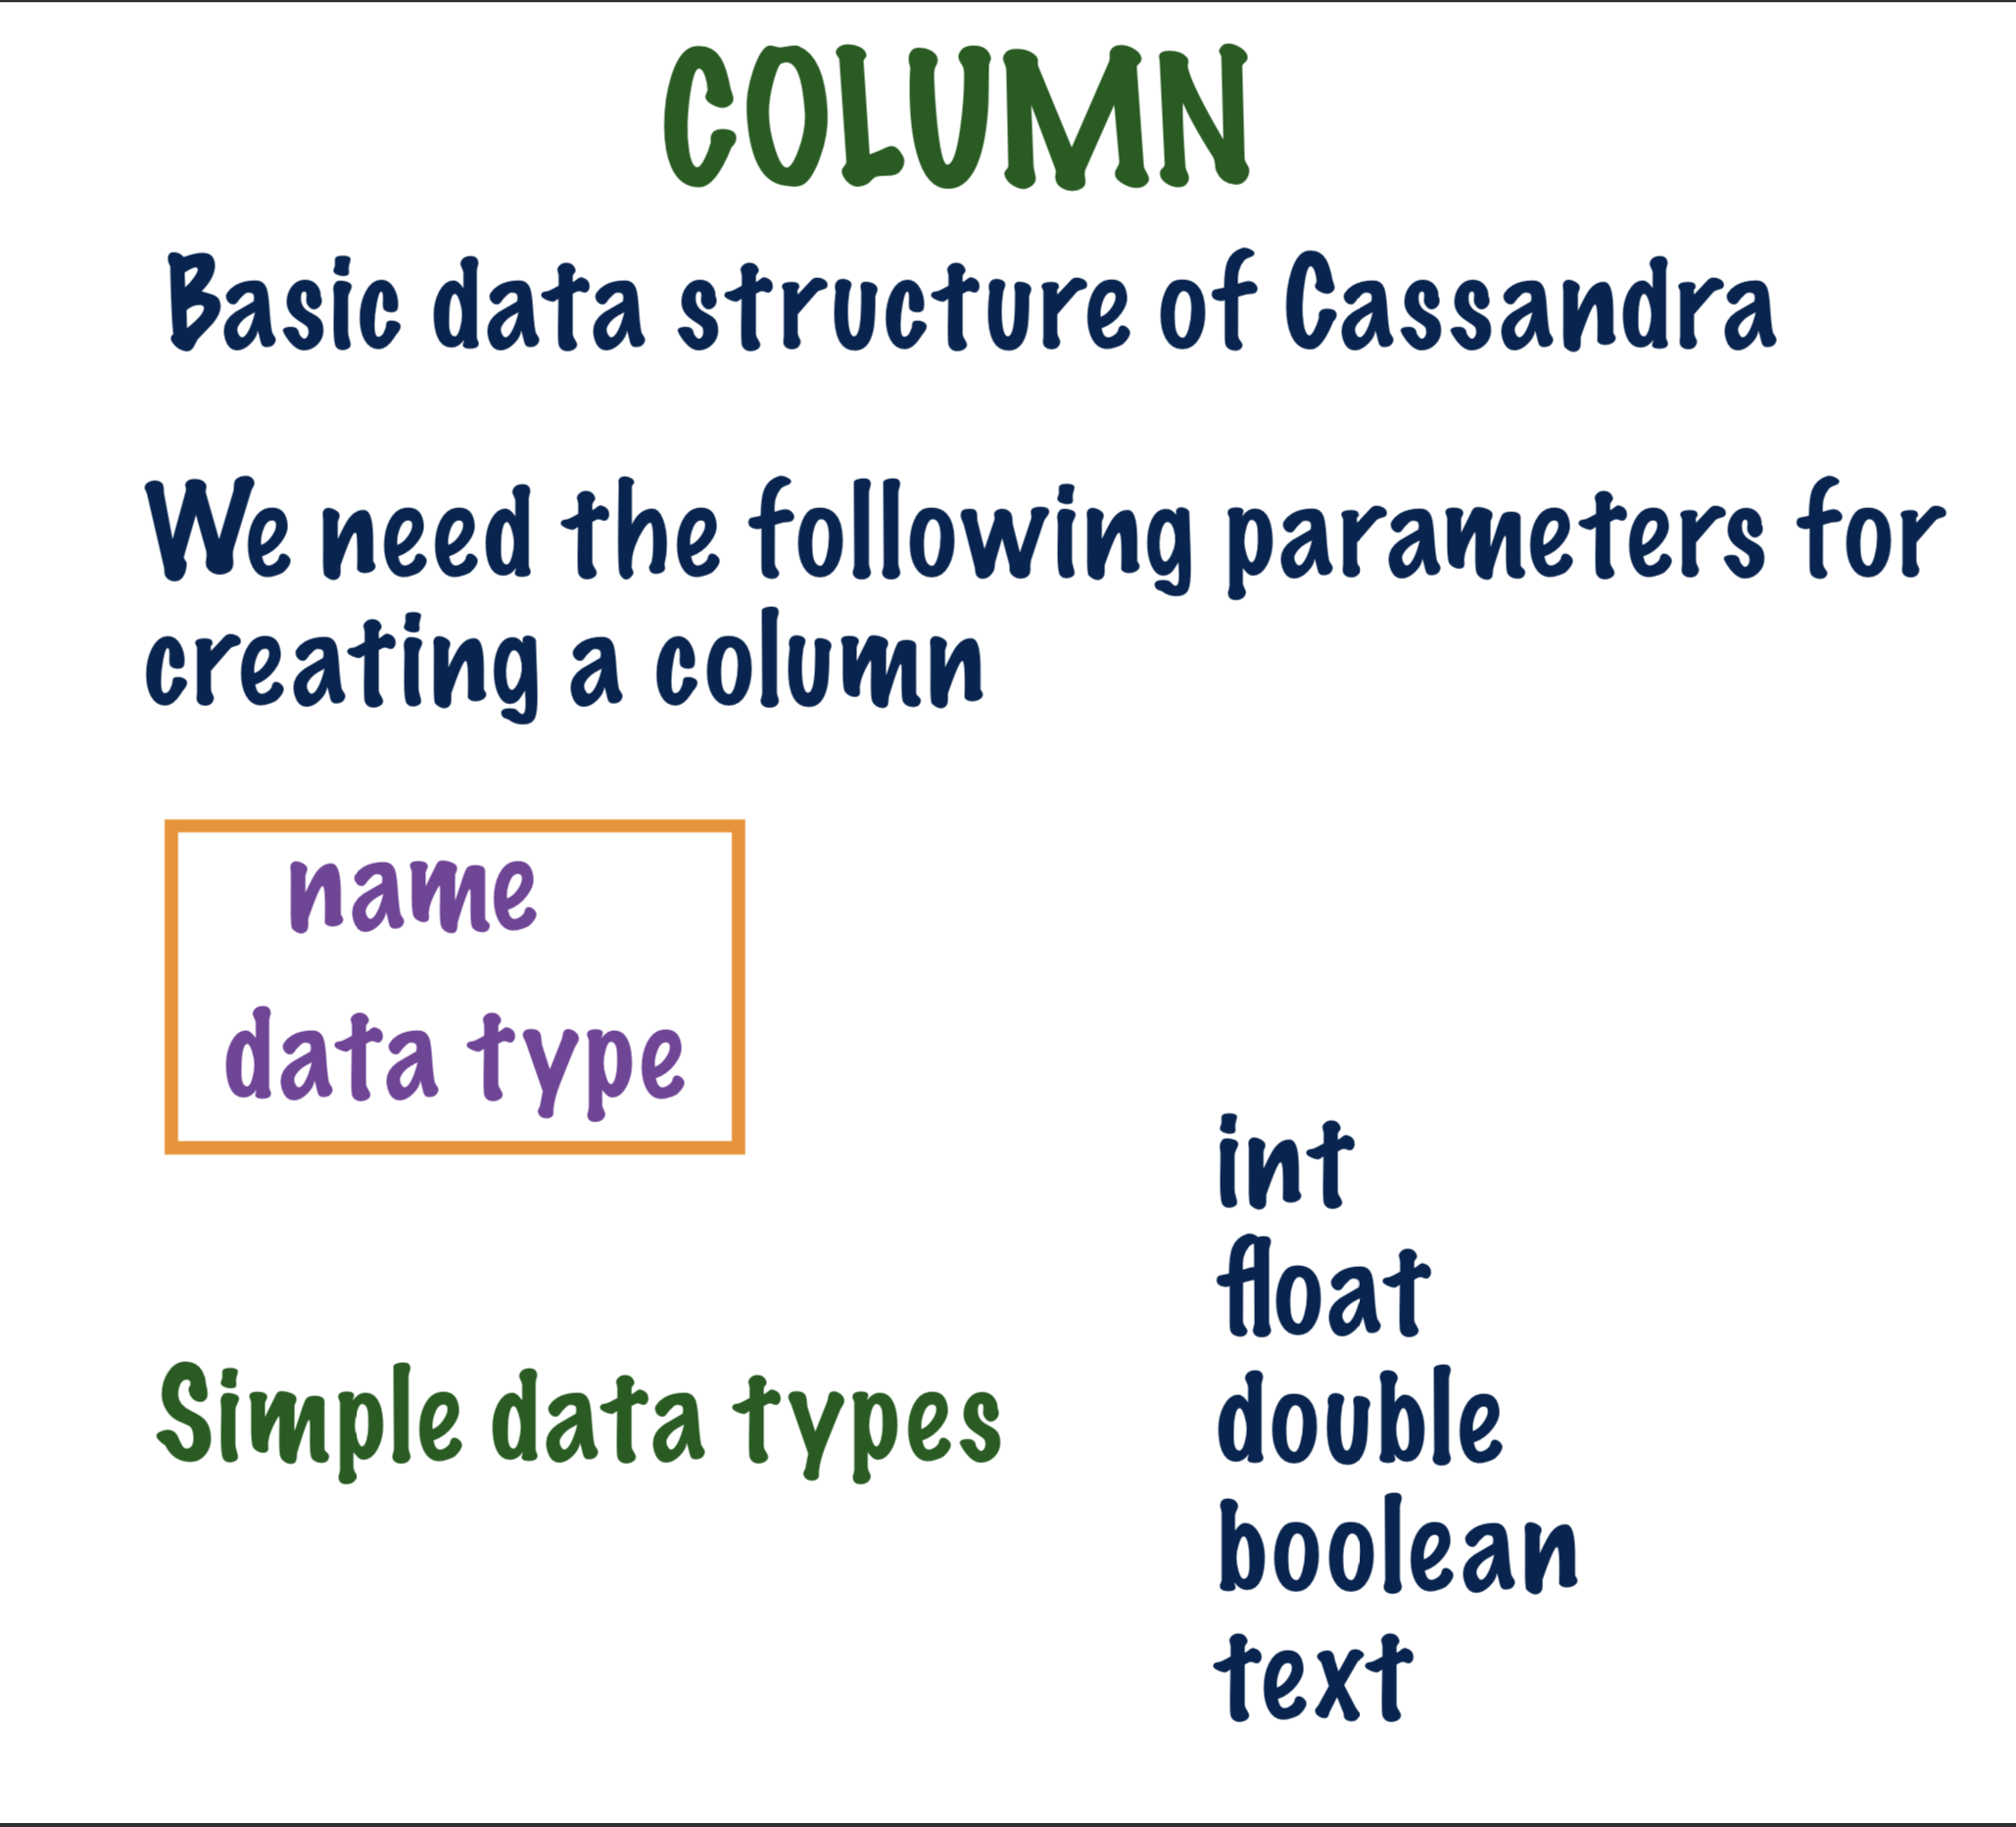

Slide 9
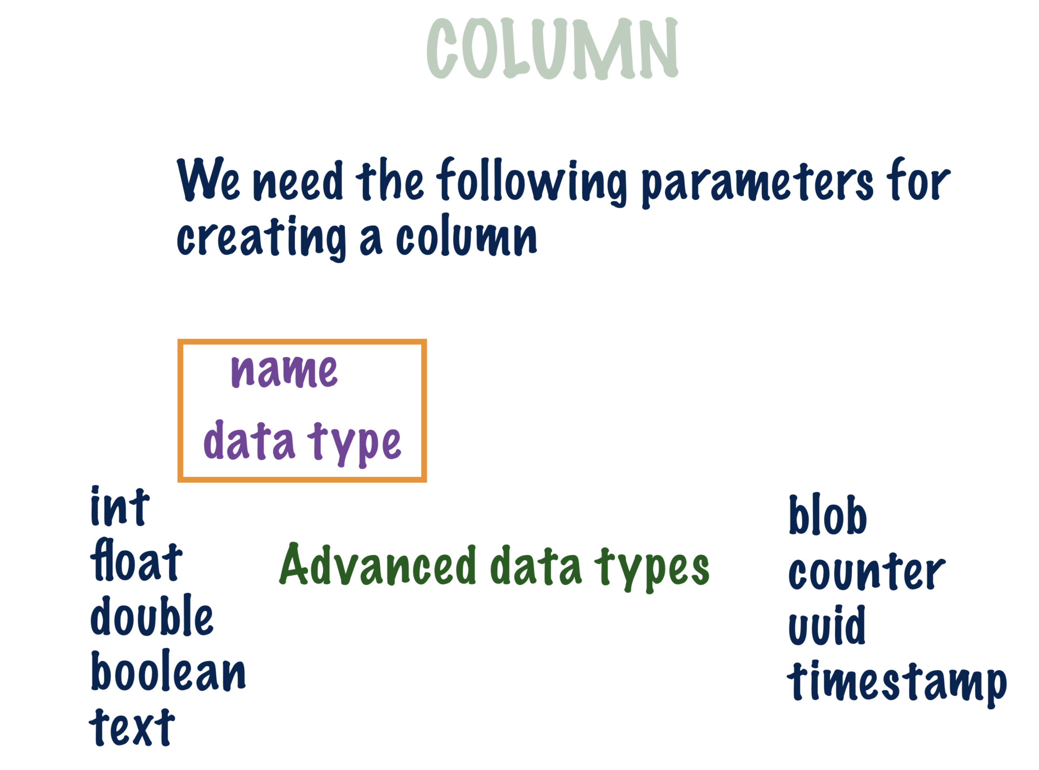

Slide 10
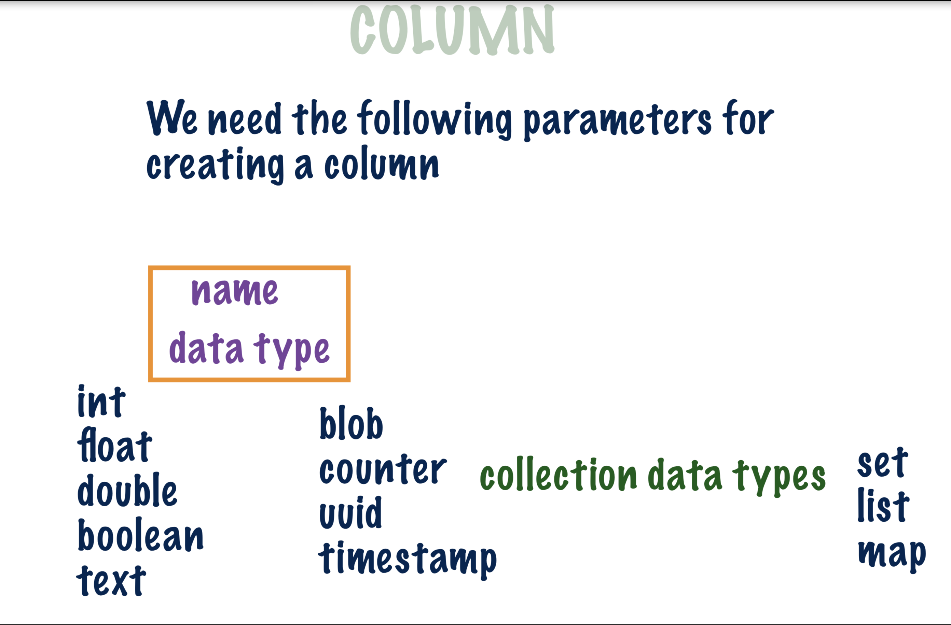

Slide 11
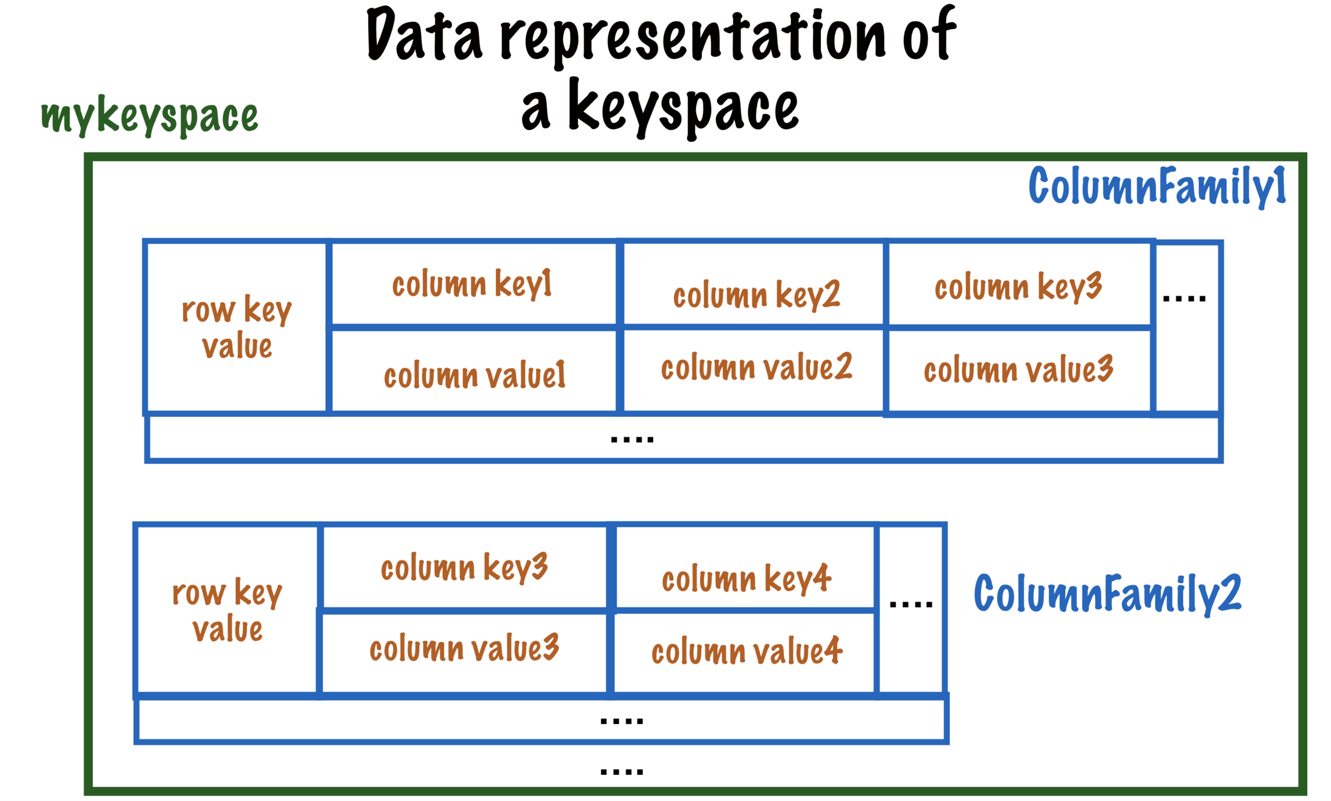

Slide 12
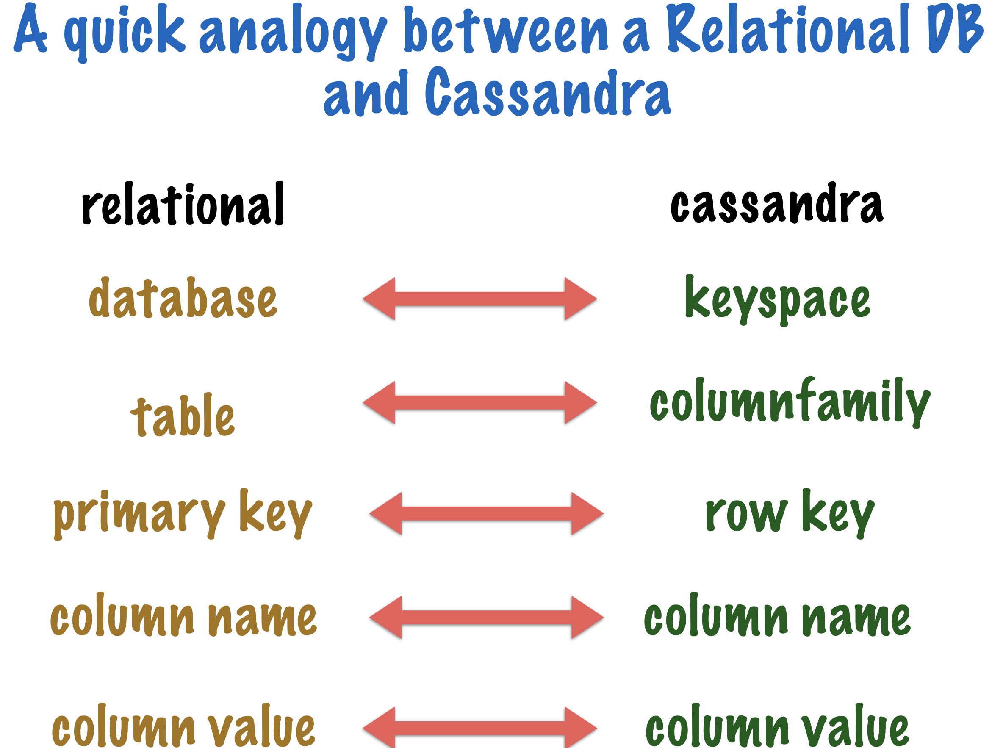

Slide 13
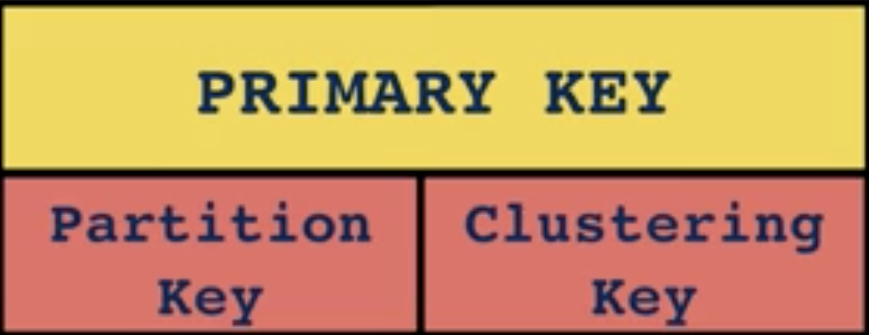
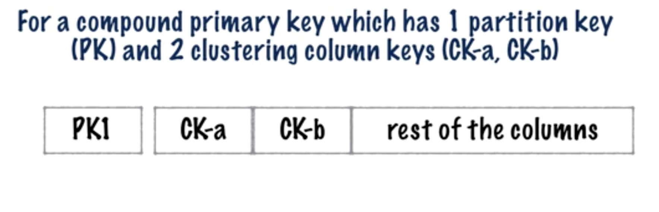
Primary Key
Partition key decides how data is distributed
Clustering key decides how the data is stored in the
disk

Slide 14
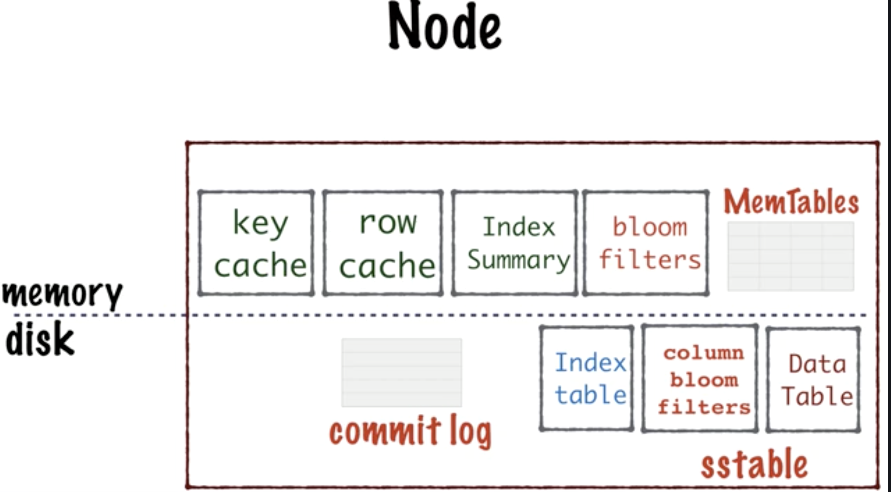
Cassandara Data Storage

Slide 15
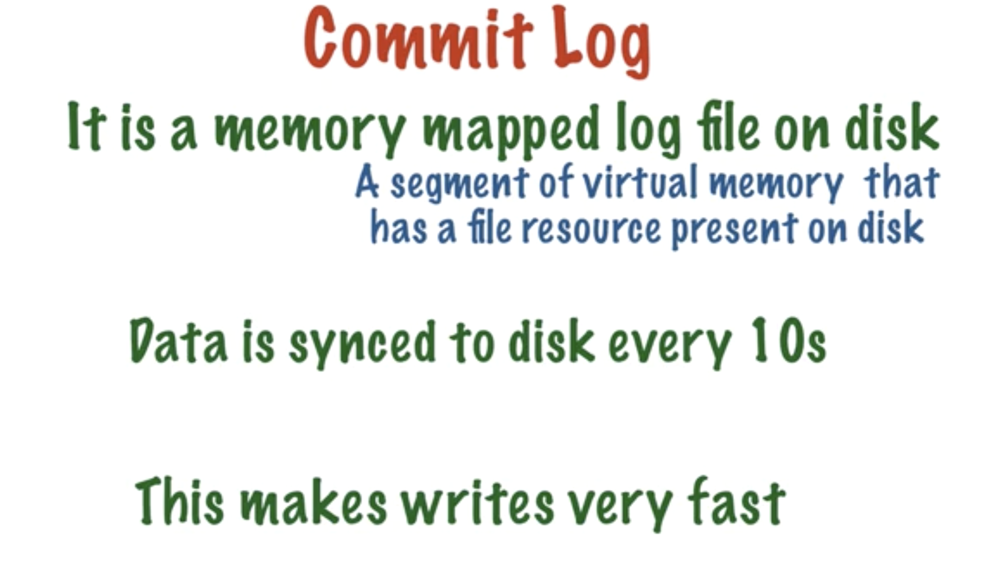

Slide 16
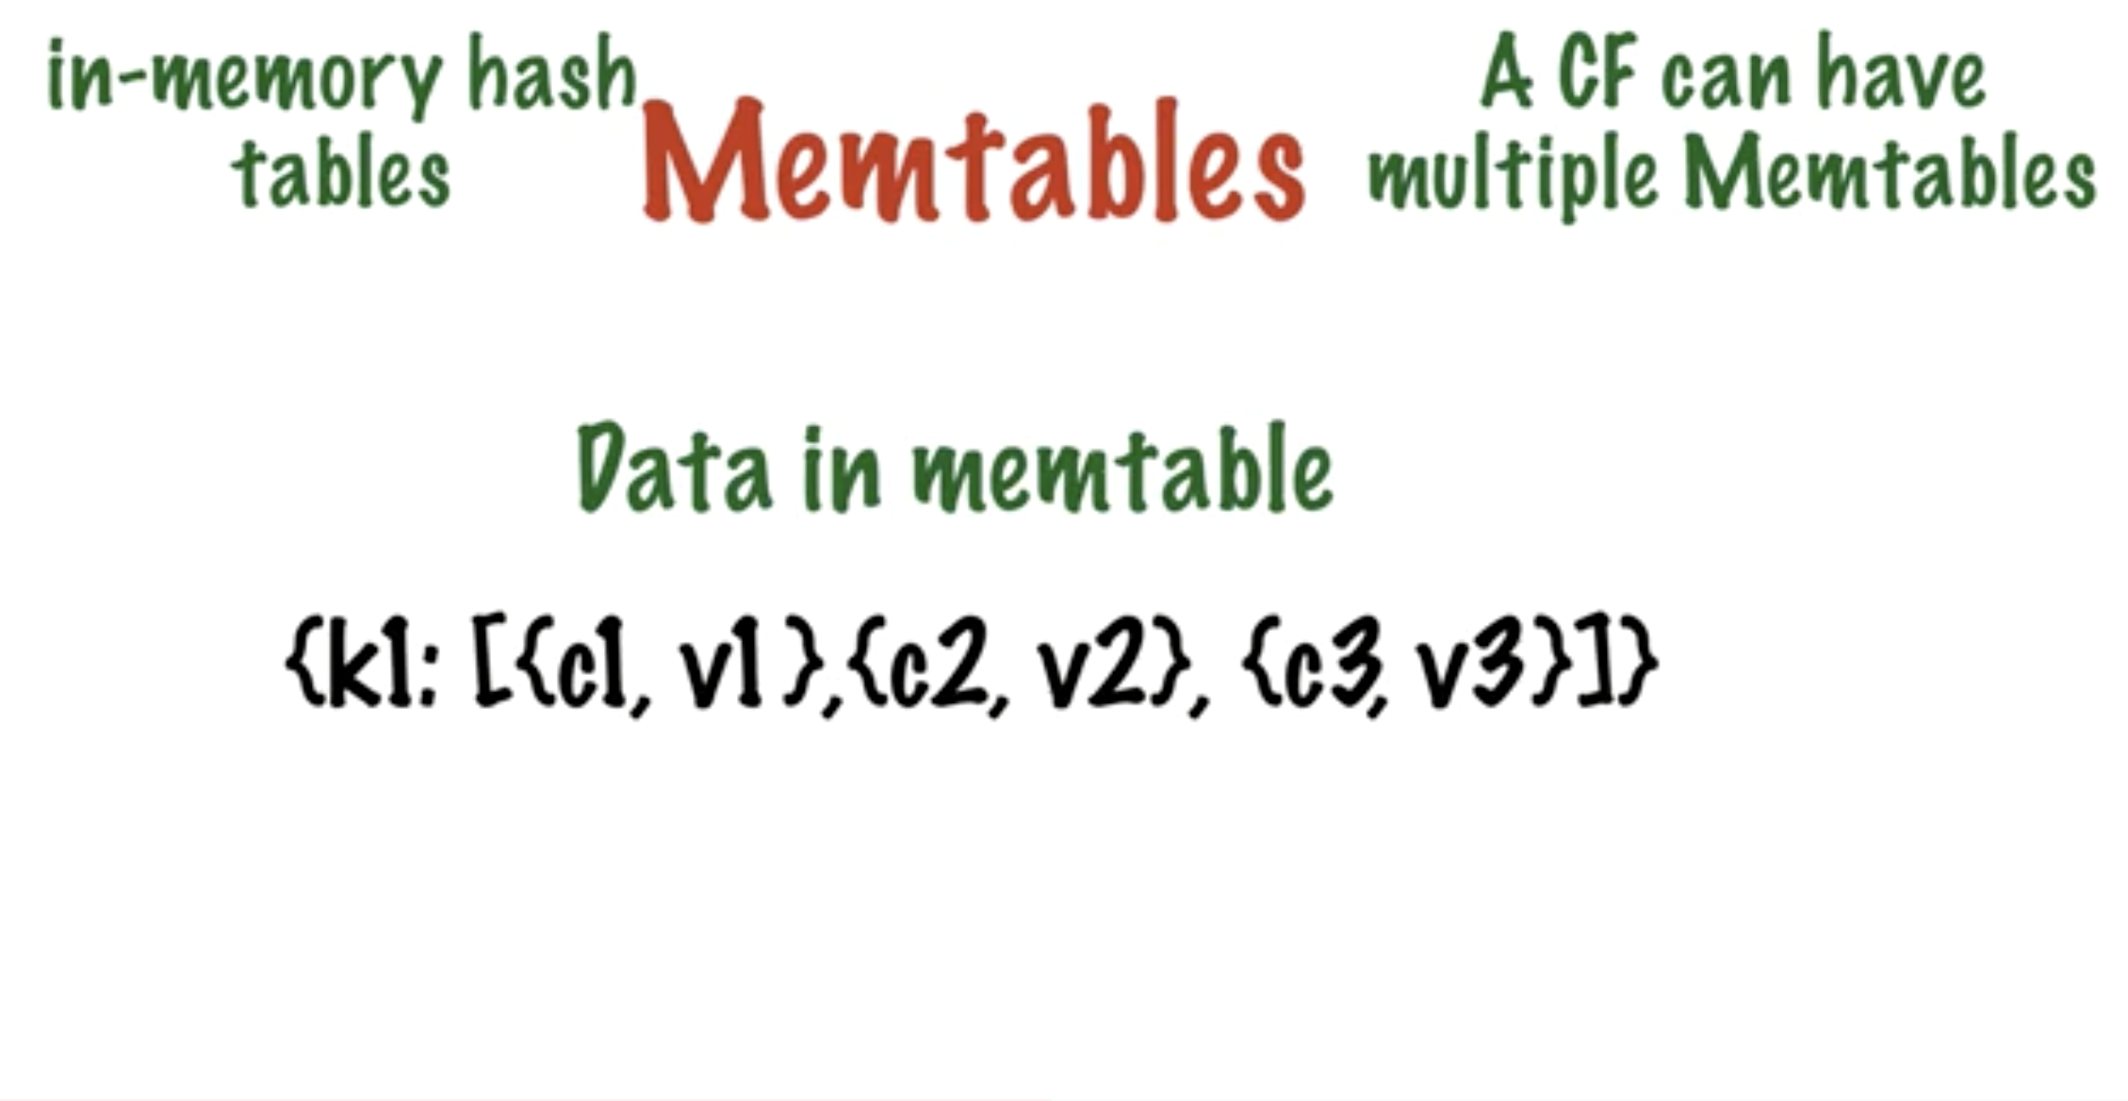

Slide 17
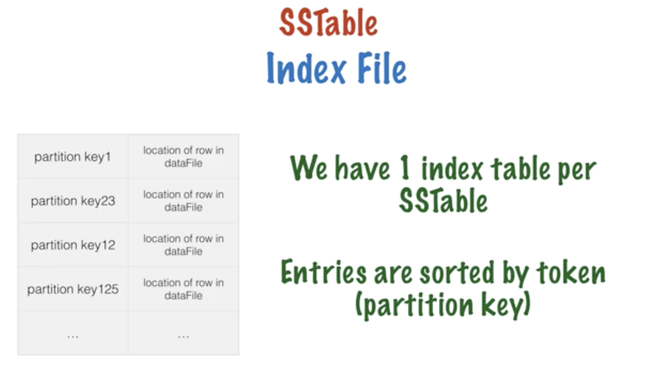

Slide 18
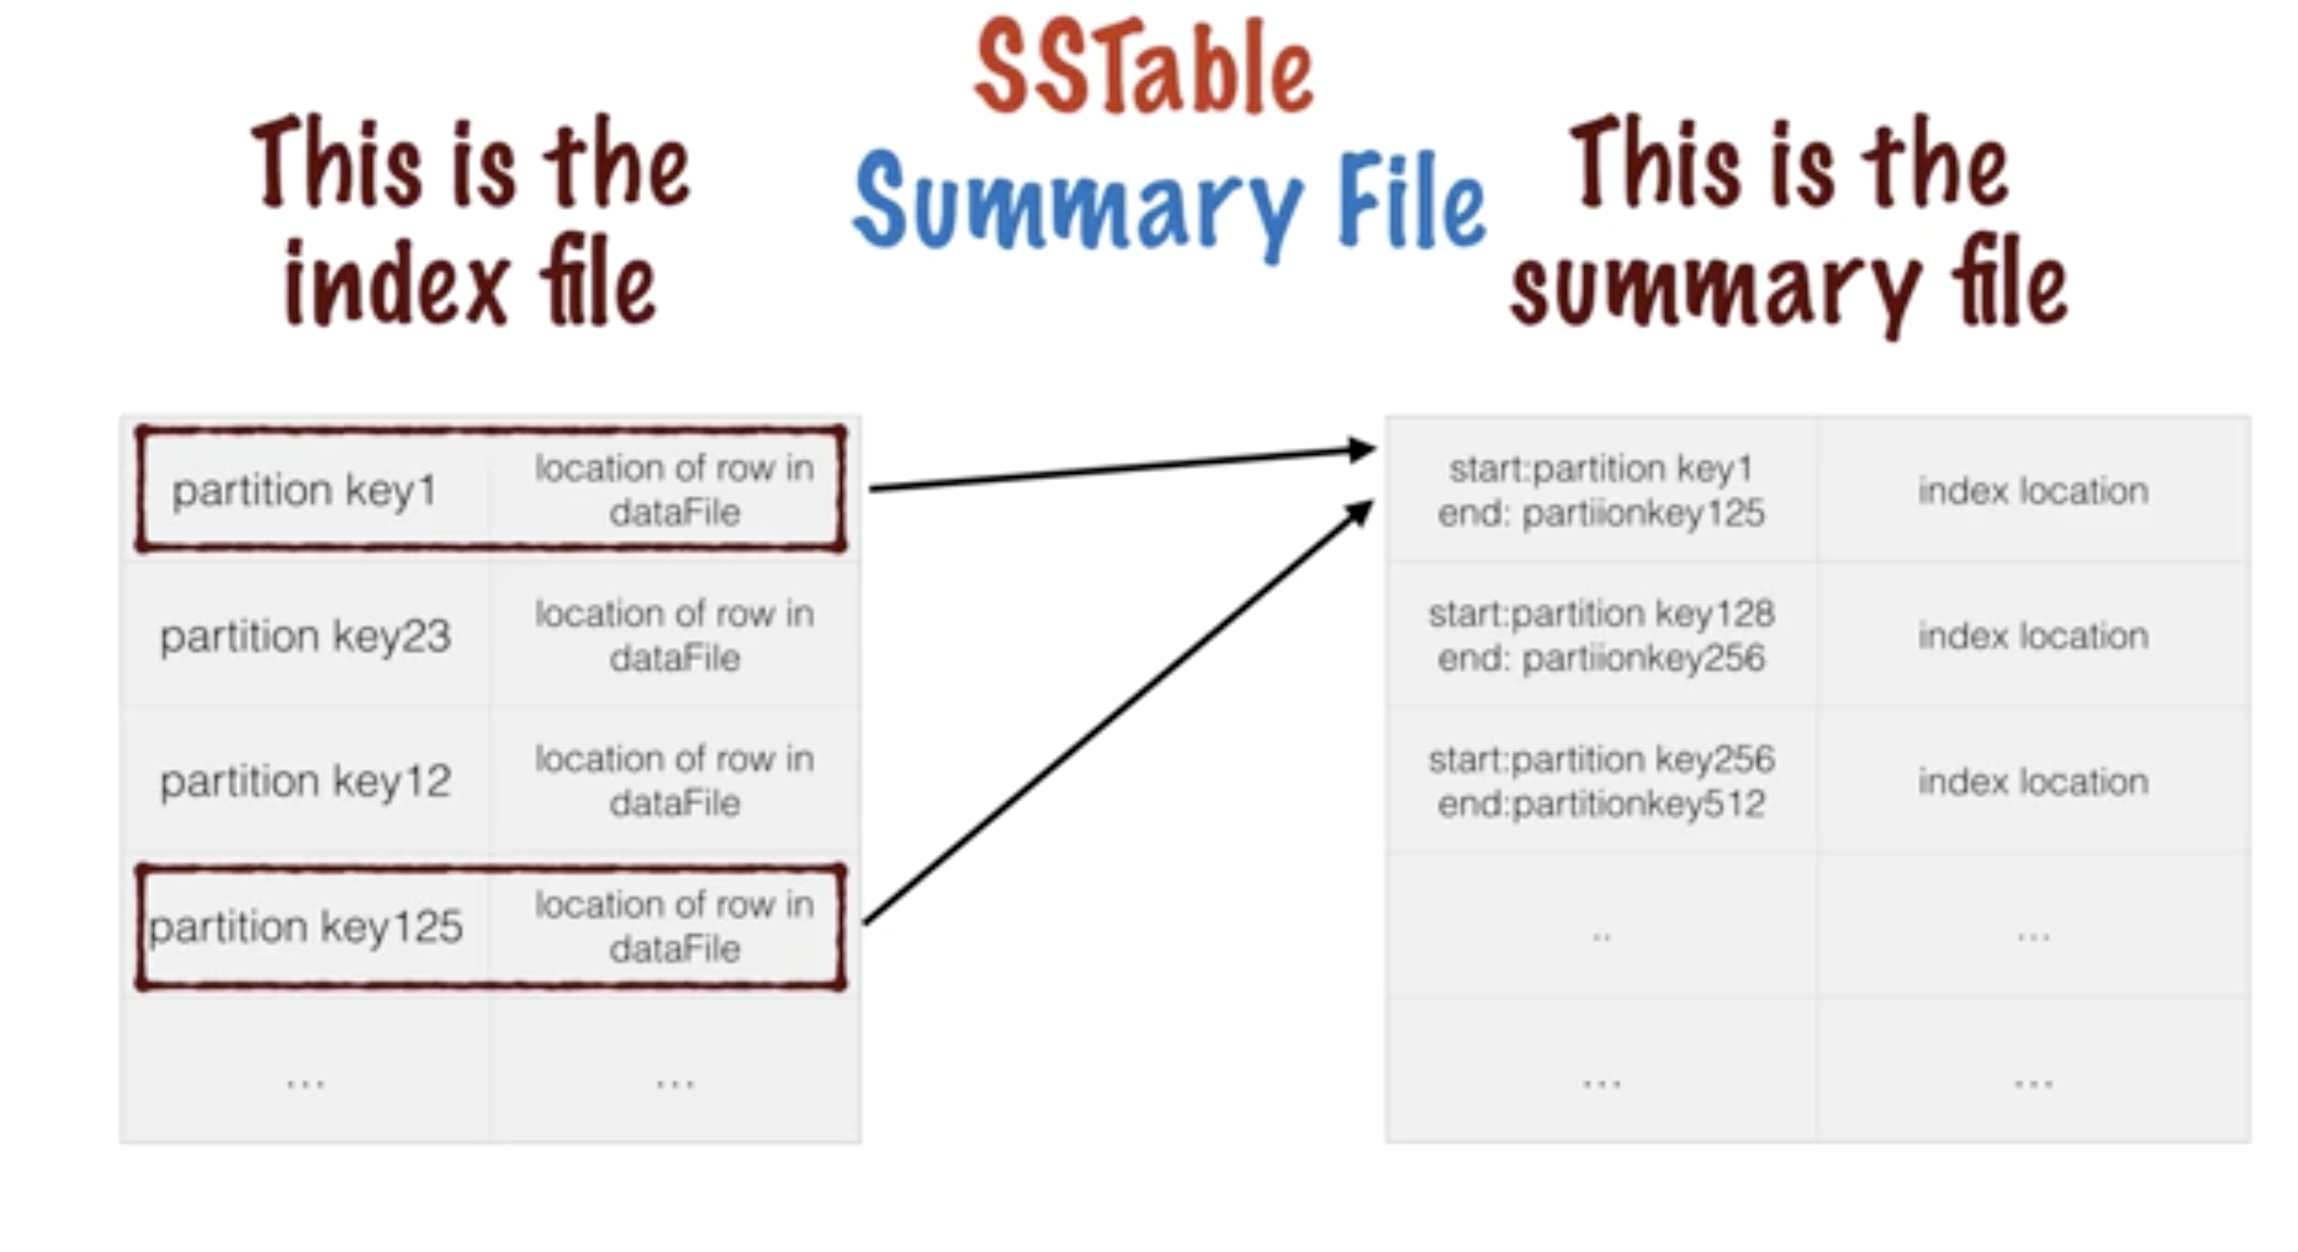

Slide 19
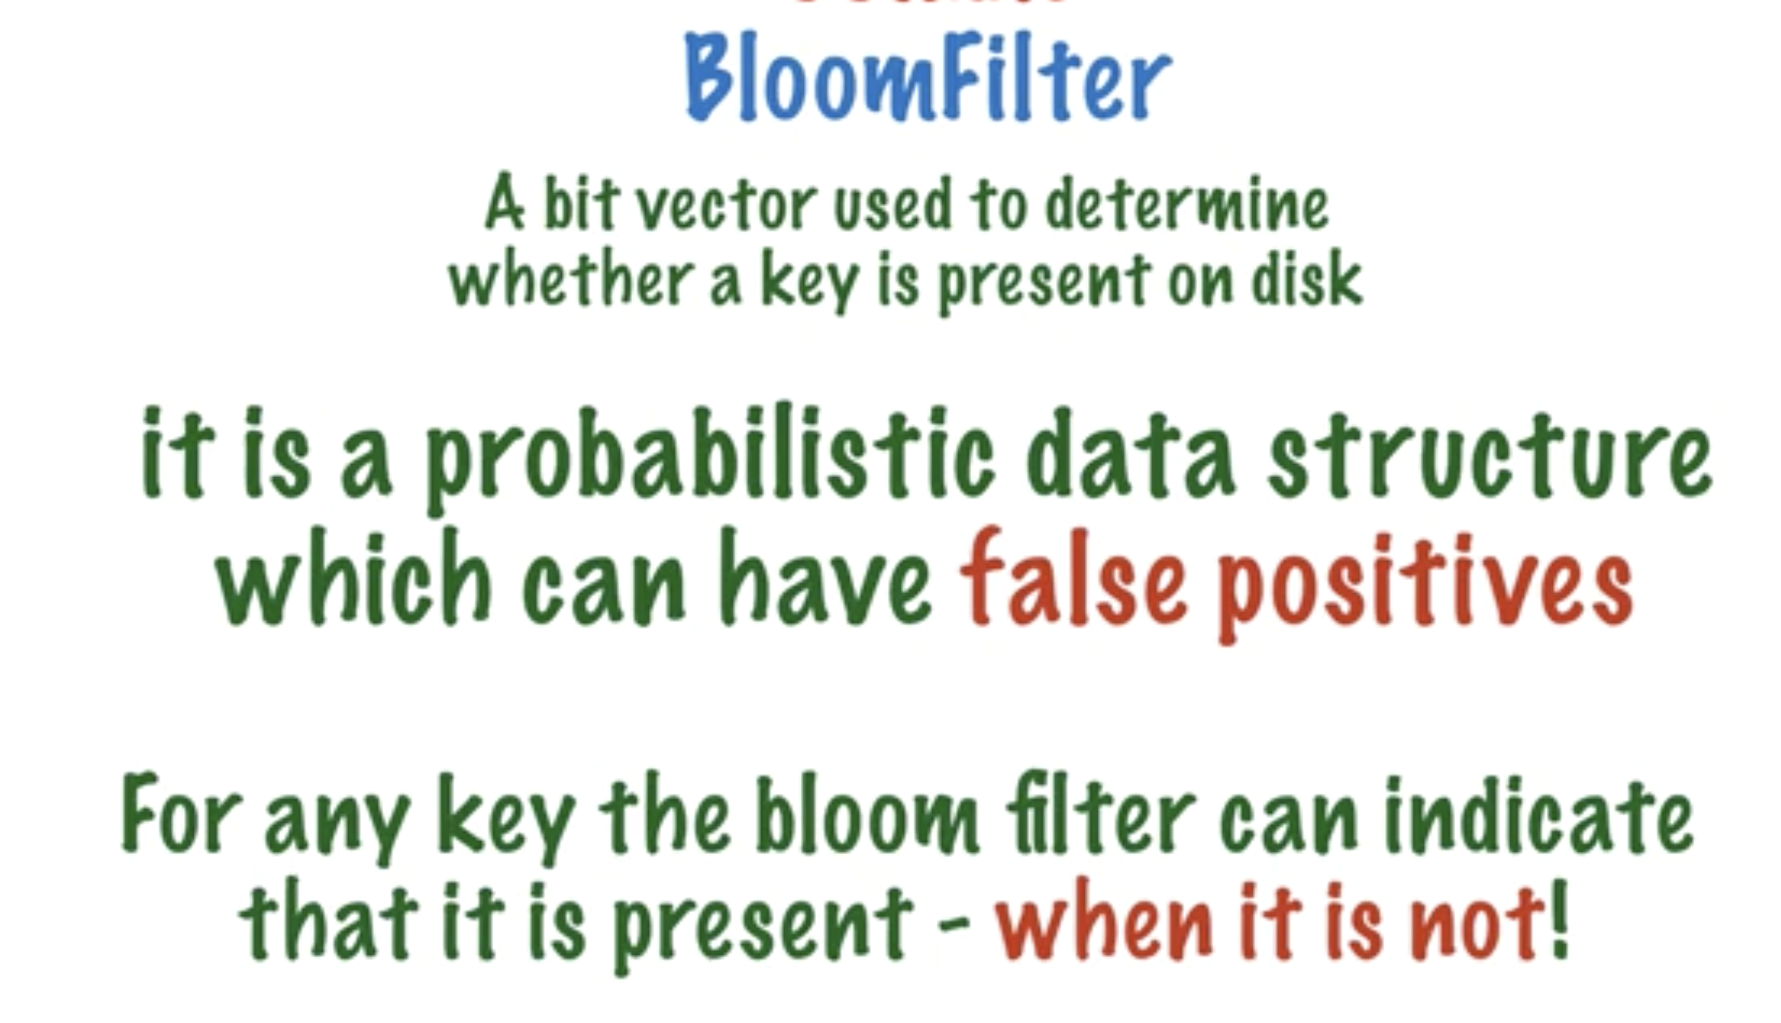

Slide 20
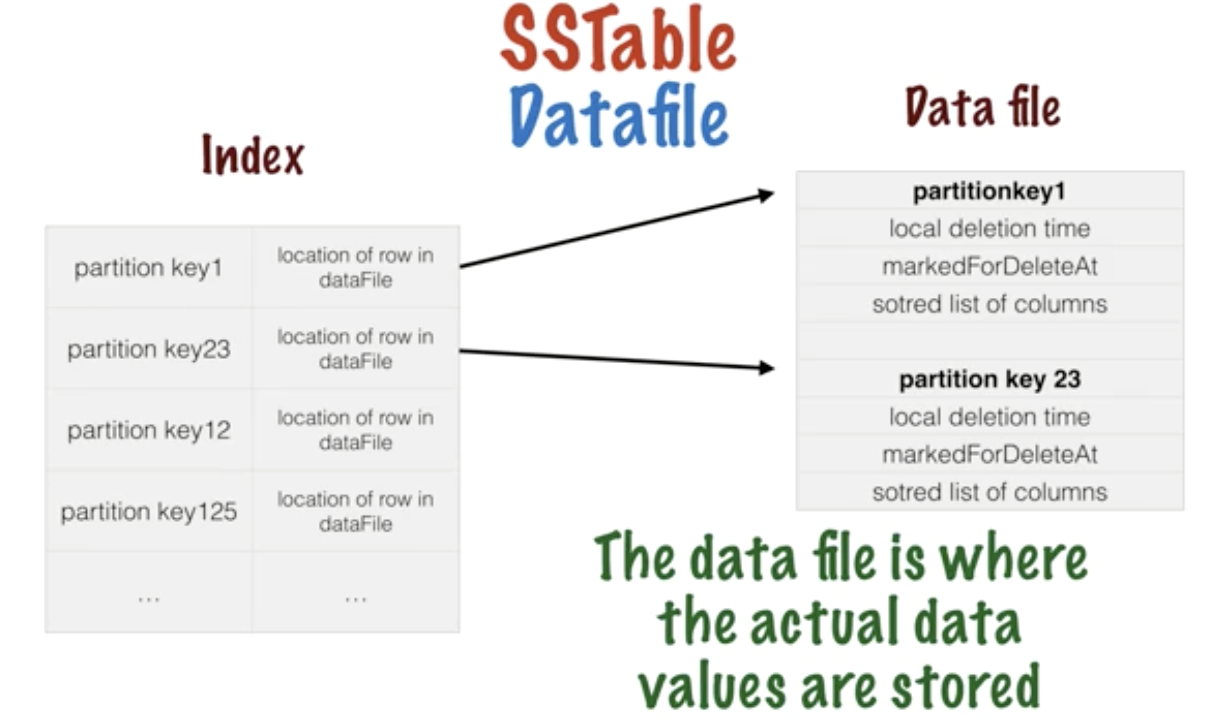

Slide 21
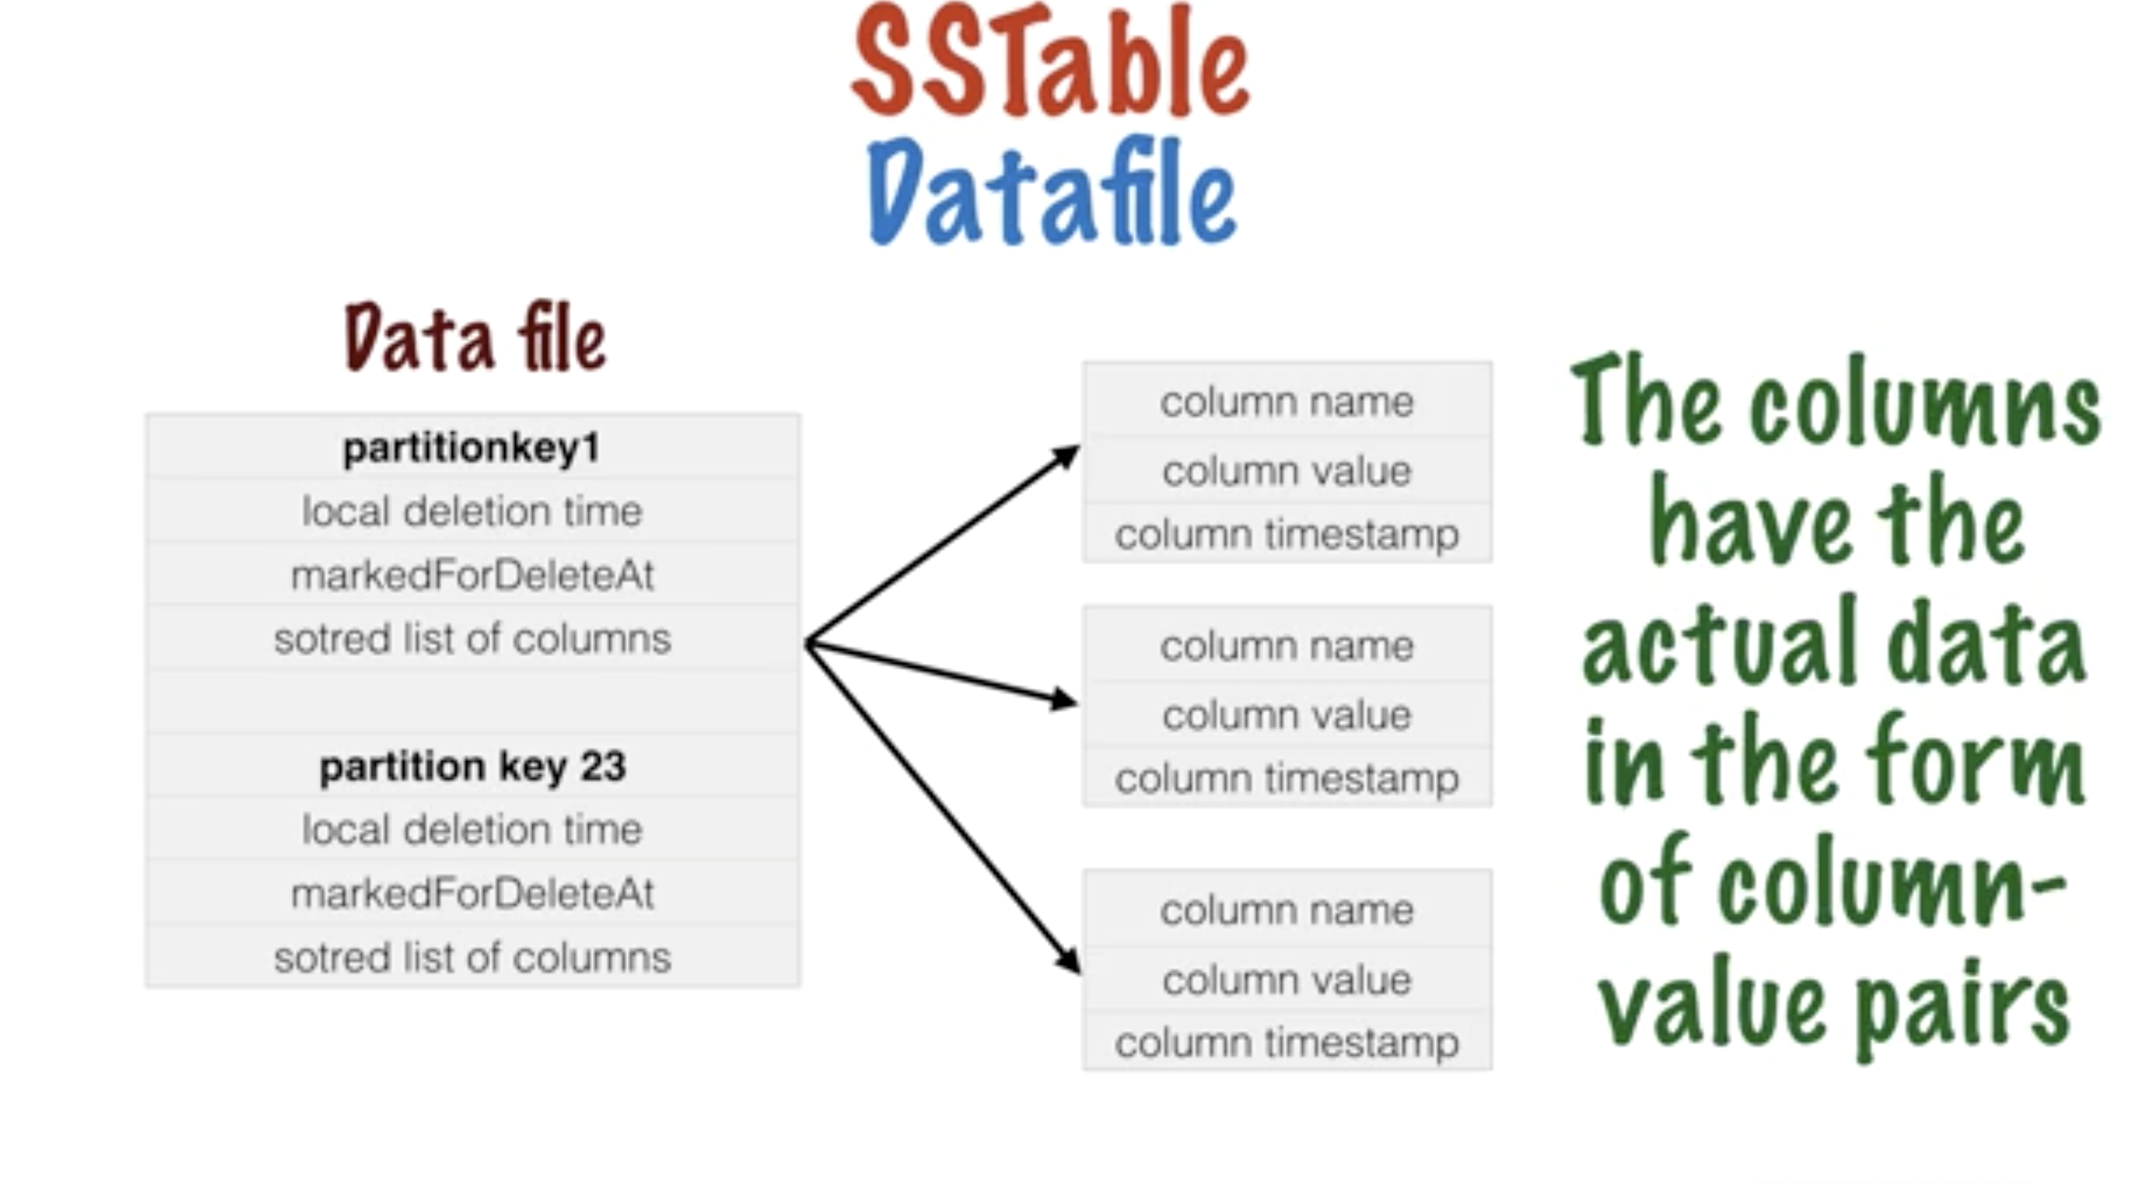

Slide 22
How Writes Happen
✔
write
INSERT INTO email_users (domain, user, username)
VALUES ('@datastax.com',’rreffner', ’rreffner@datastax.com');
memtable A
memtable B
memory
disk or SSD
commit log
sstable A
sstable B v2
sstable B
sstable B
Compaction
Merge sstables
Evict tombstones
Rebuild indexes
Is a background process
append
fsynch
SSTables are immutable

Slide 23
How Reads Happen
✔
✔
✔
read
row cache
SELECT * FROM email_users
WHERE domain= '@datastax.com’
AND user = ’rreffner@datastax.com’;
memtable A
* can be in-memory table
bloom filter
key cache
memtable B
memory
OS cache
disk or SSD
commit log
sstable A
sstable B

Slide 24
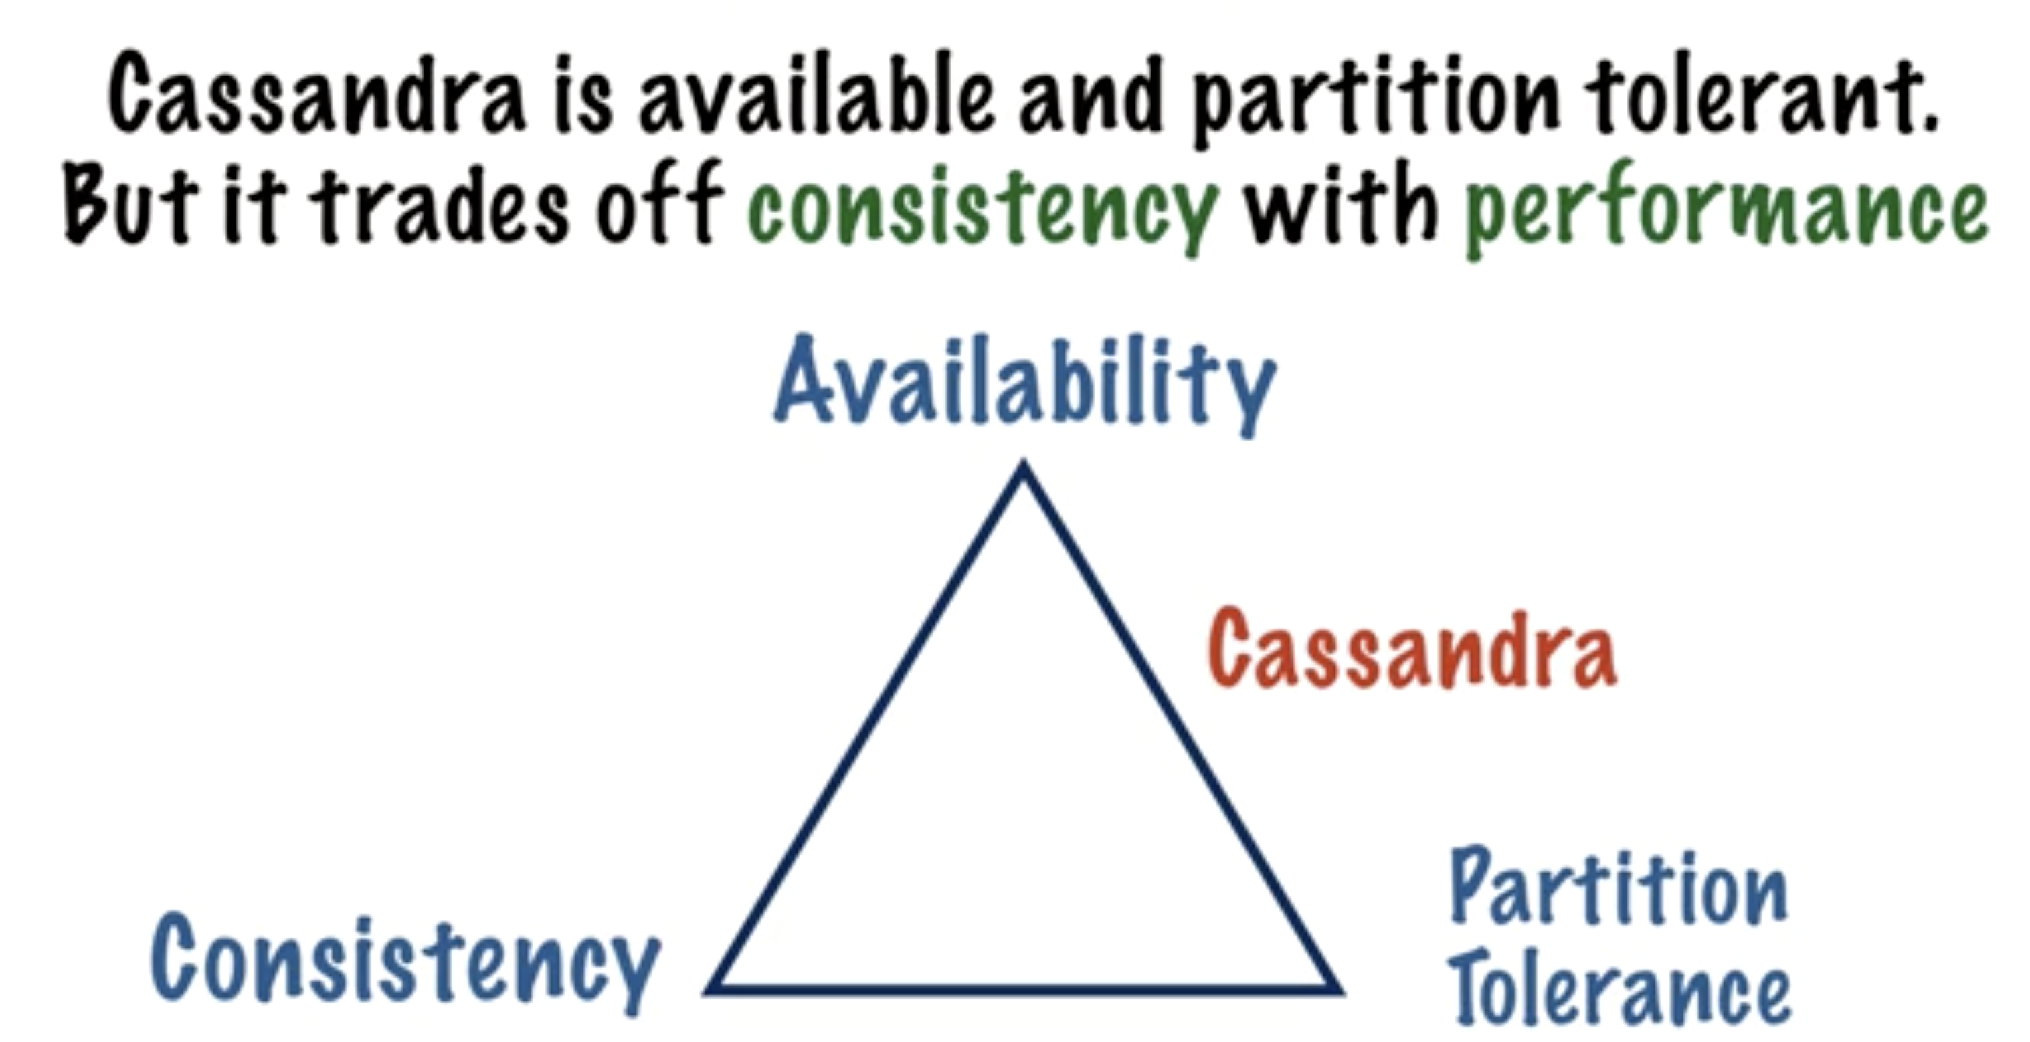
CAP THEORAM

Slide 25
Transaction Load Balancing
Application
driver
Driver manages connection pool
Driver has load balancing policies that can be applied
Each transaction has a different connection point in the cluster
Asynch operations are faster
80
70
10
60
20
Data Center 1
50
30
40

Slide 26
Data Partitioning
Driver selects the Coordinator node per operation via load balancing
Partitioned token ranges
Random Partitioner
Murmur3 Partitioner
Tokens in the range -2^{^63} to 2^{^63}-1
Each entire row lives on a node
Application
driver
insert key=‘x’;
hash(key) => token(43)
80
70
10
60
20
Data Center 1
50
30
40

Slide 27
Replication
Replication Factor = # of copies
All replication operations in parallel
“Eventual” = micro- or milliseconds
No master or primary node
Each node acknowledges the op
Replication Placement Strategy
Application
driver
insert key=‘x’;
hash(key) => token(43)
80
70
10
60
20
Data Center 1
50
30
40
replication factor = 3

Slide 28
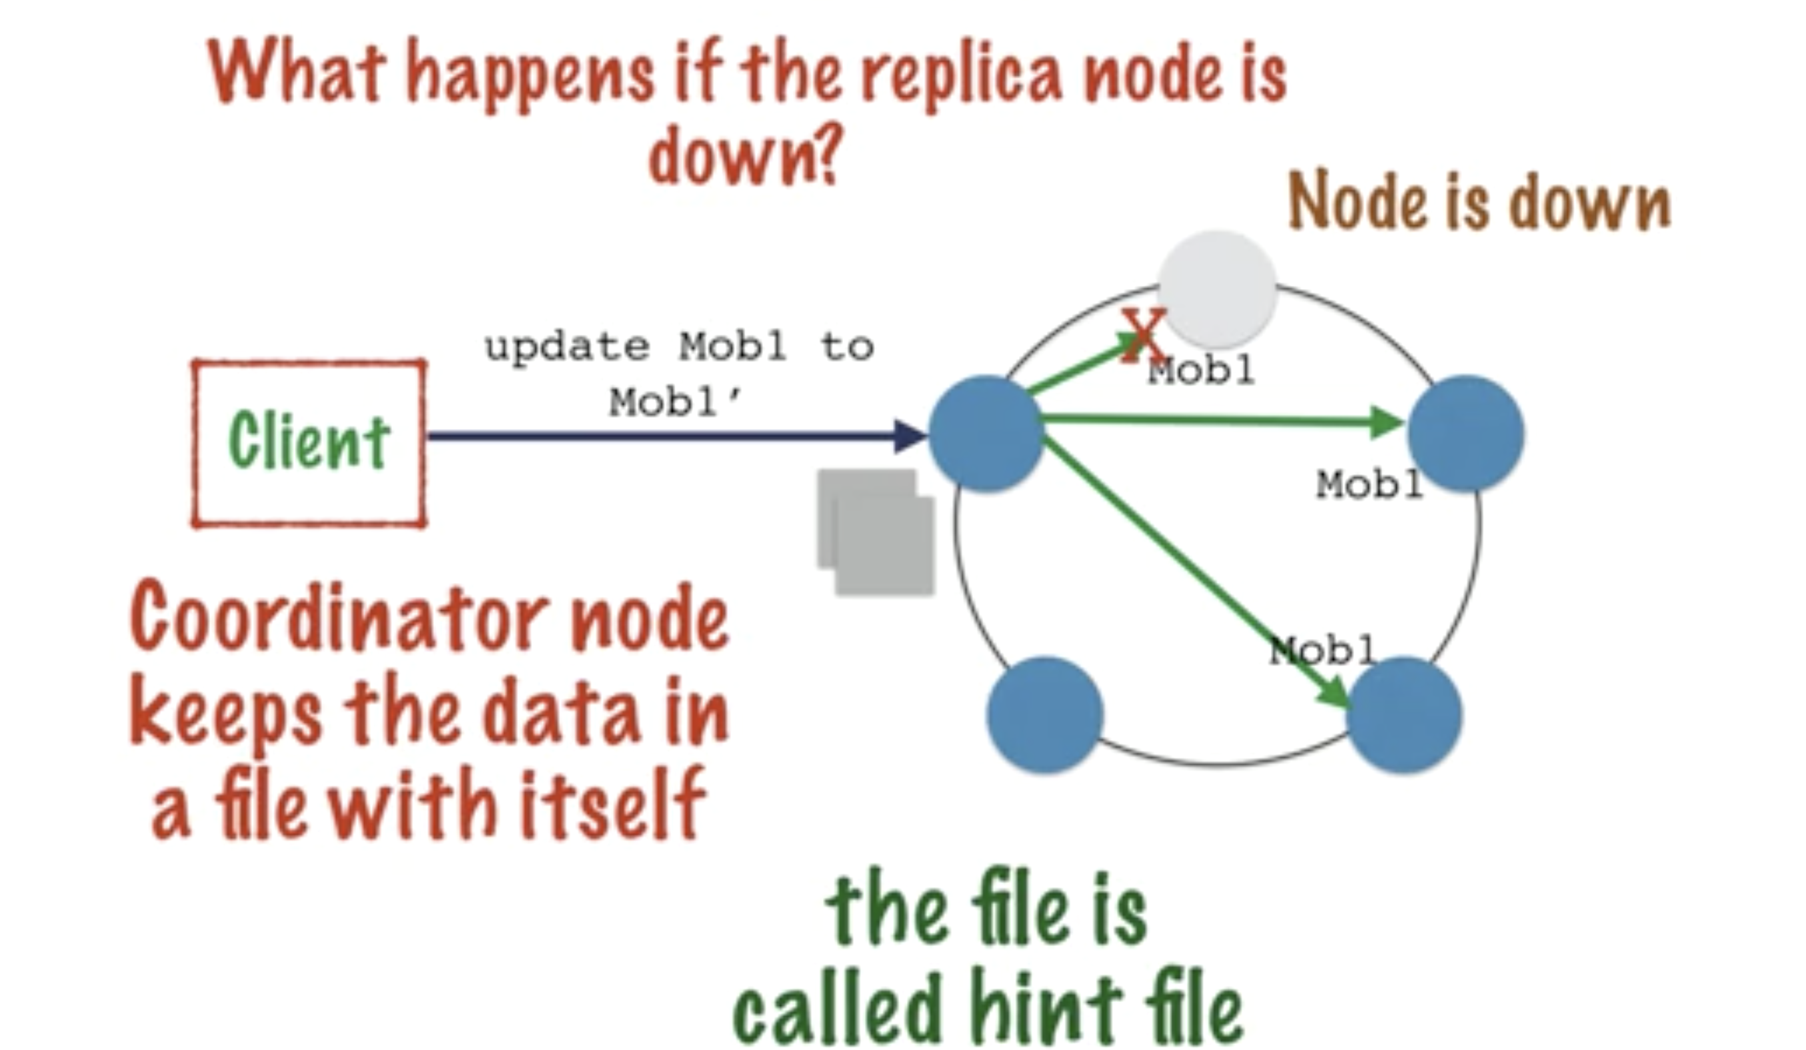

Slide 29
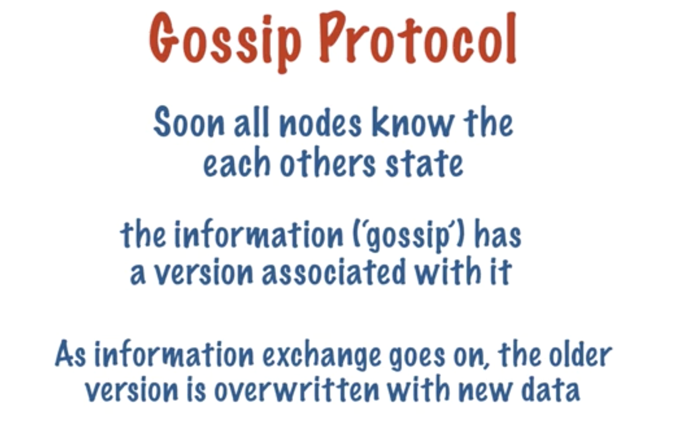

Slide 30
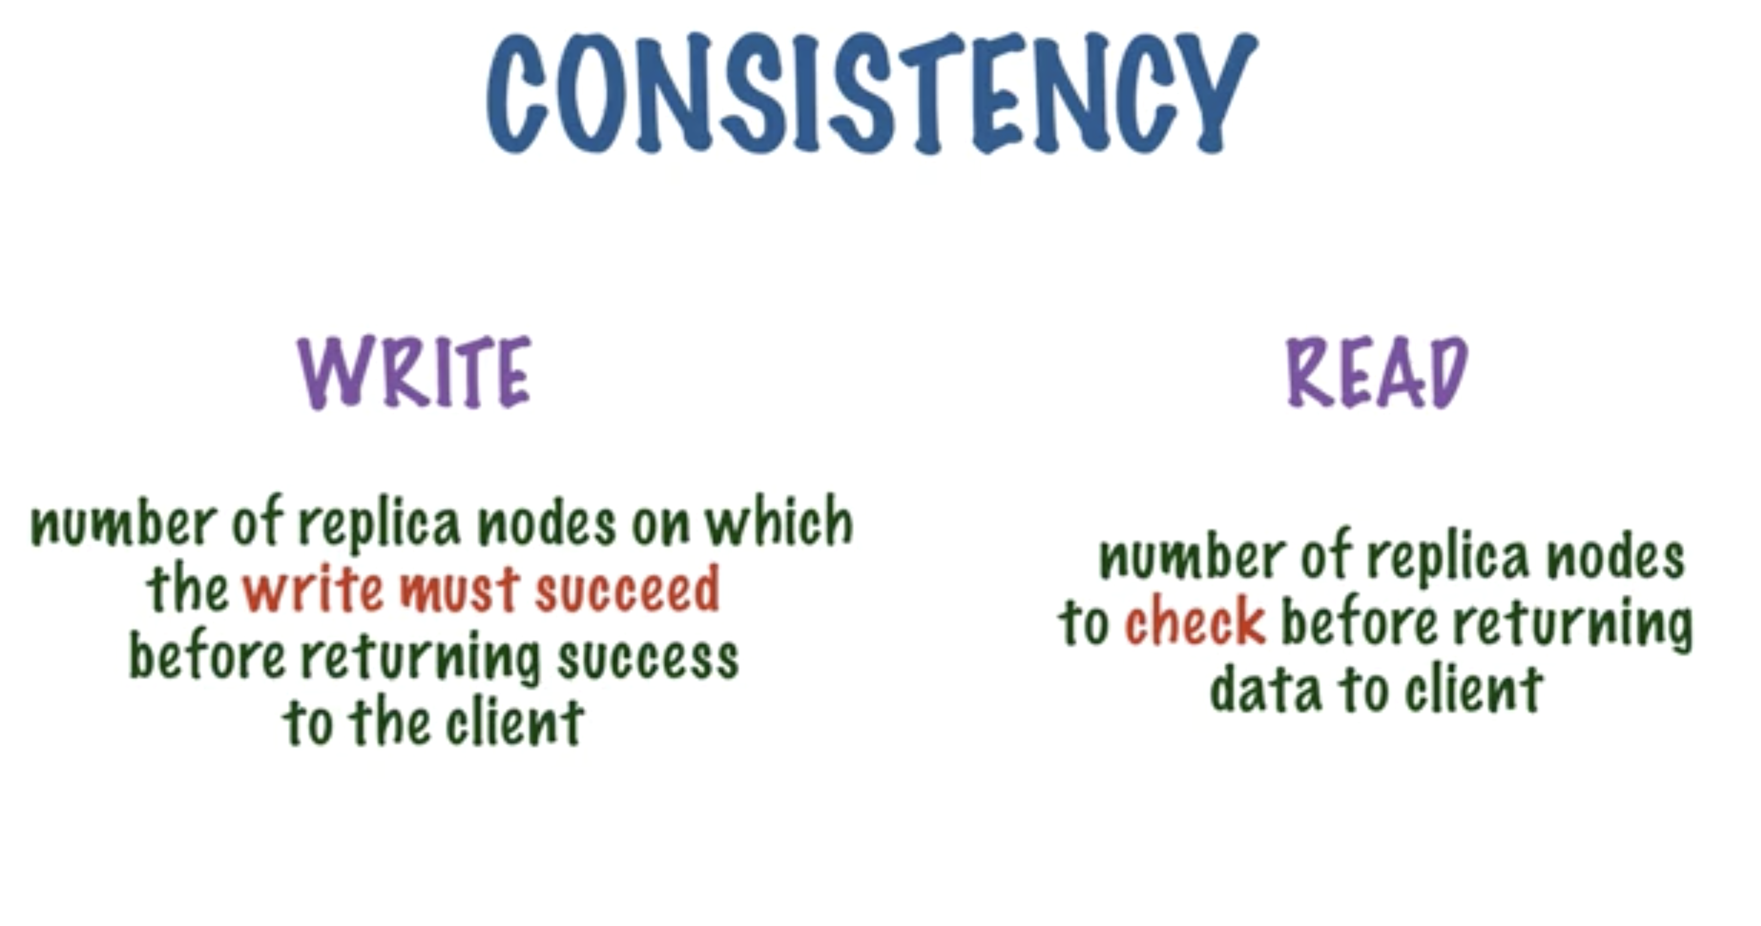

Slide 31
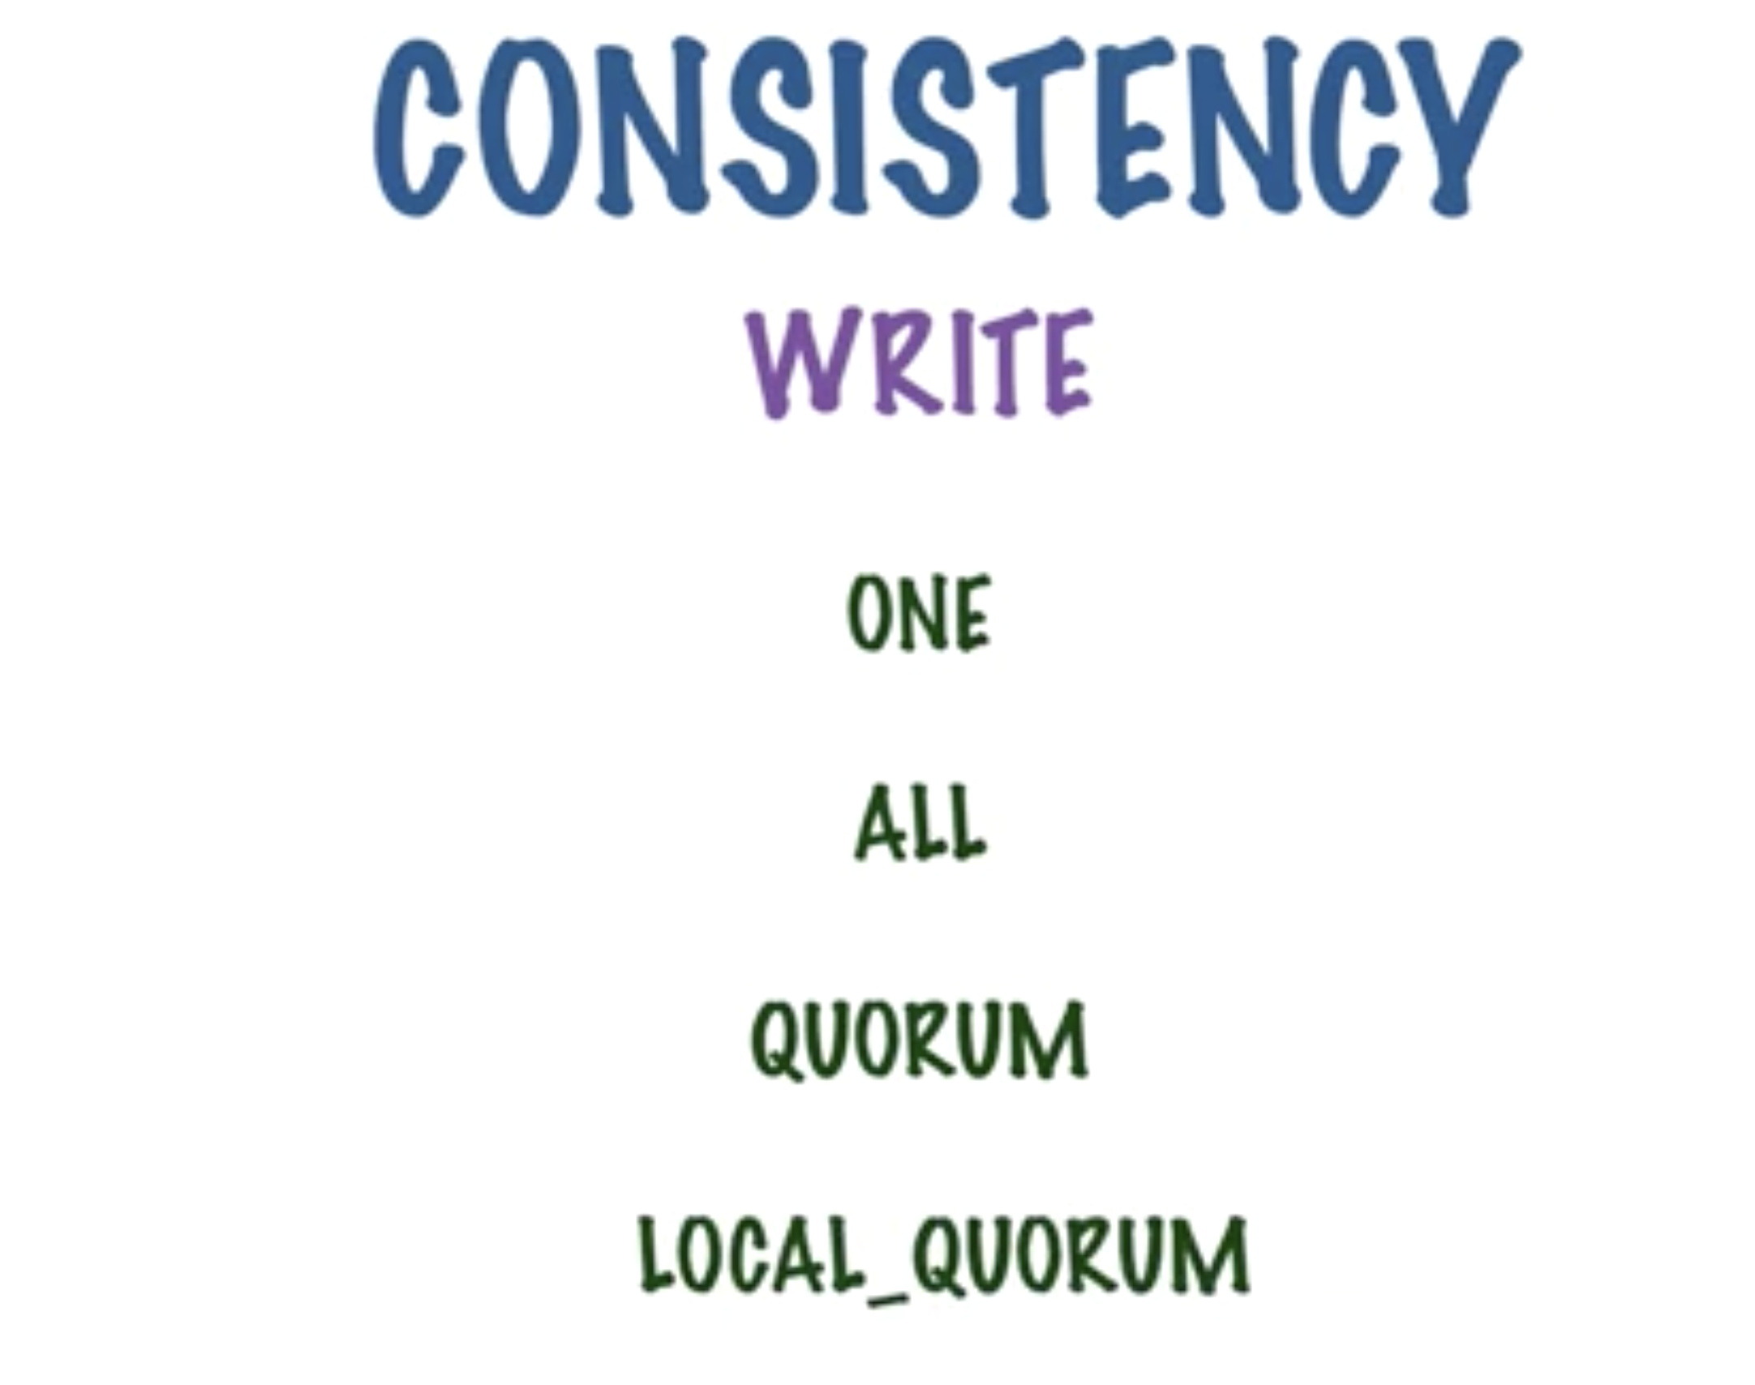

Slide 32
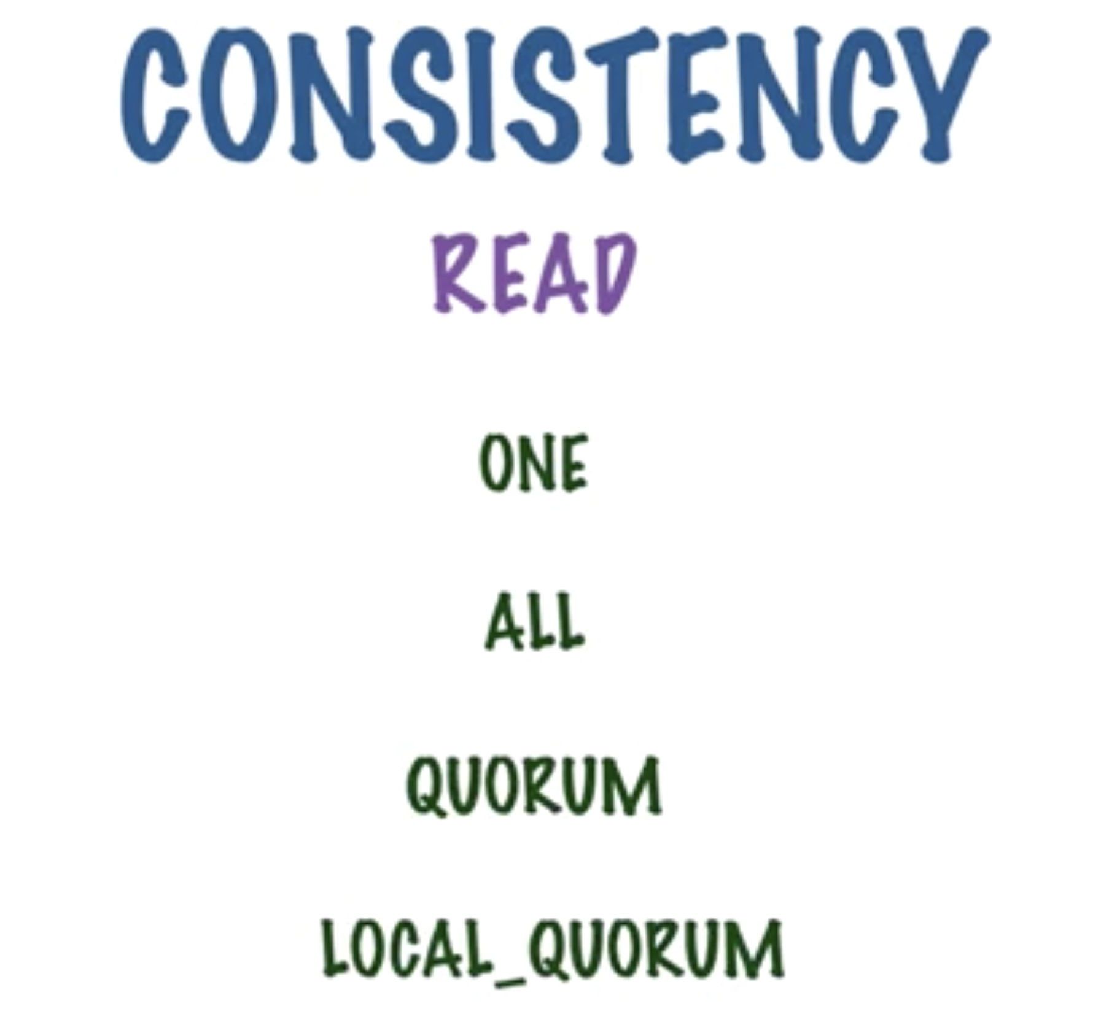

Slide 33
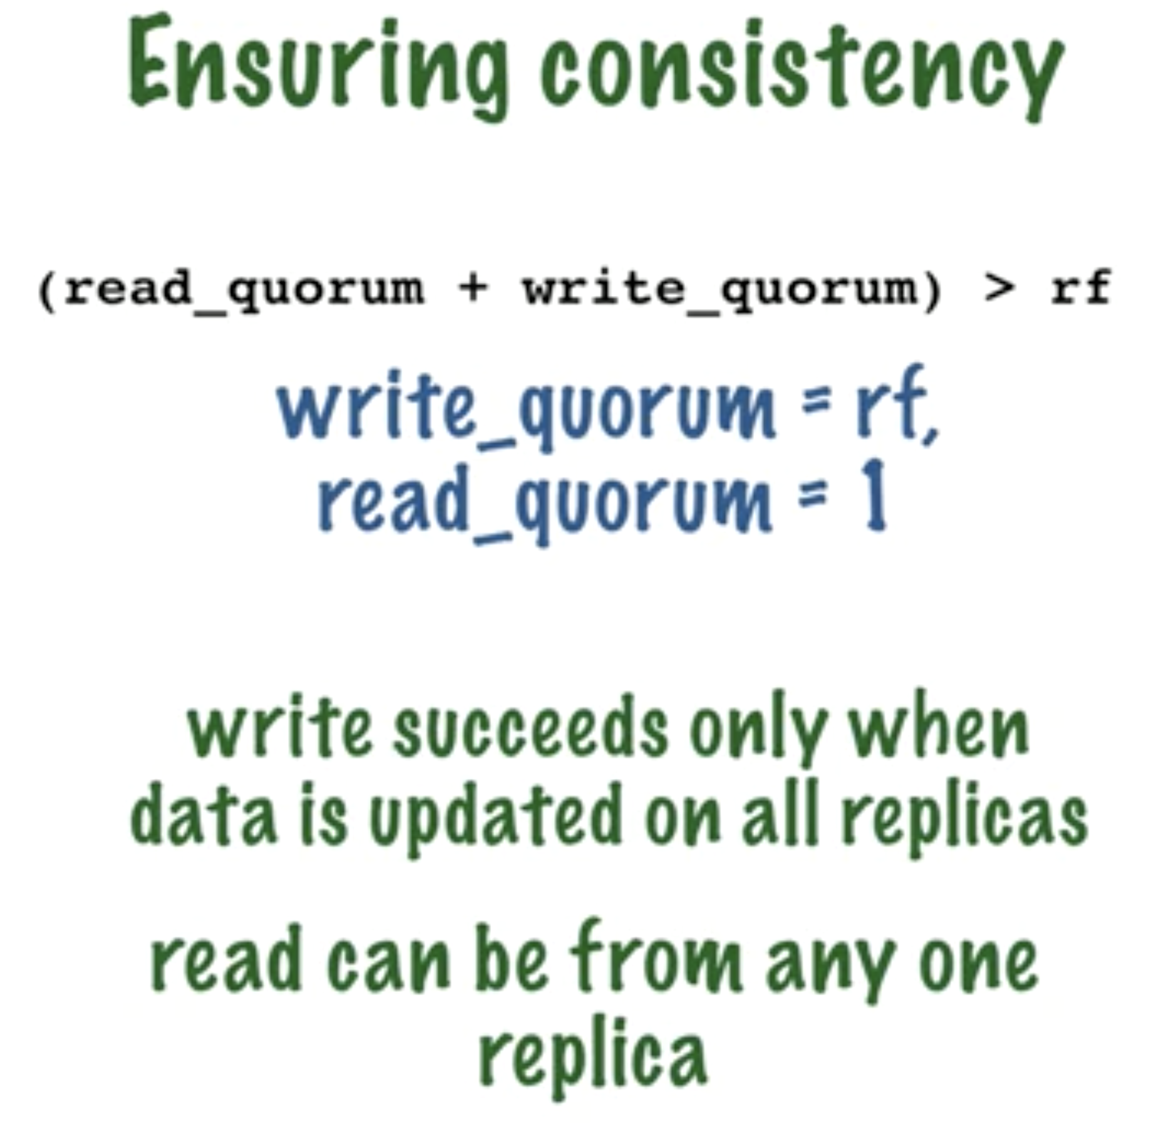

Slide 34
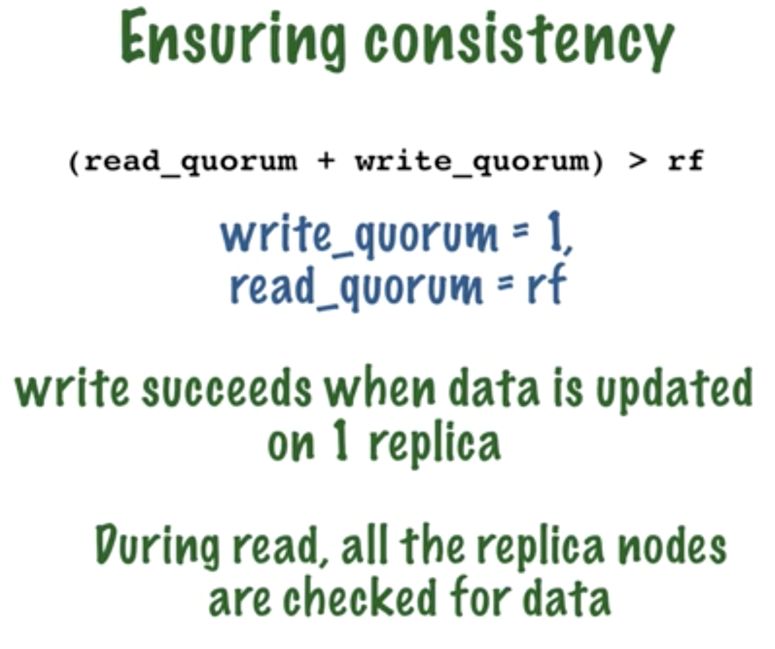

Slide 35
RDBMS: Domain-based model Cassandra: Query-based model

Slide 36
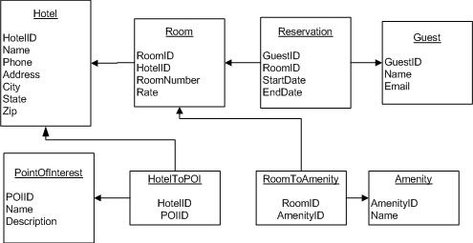
RDBMS

Slide 37
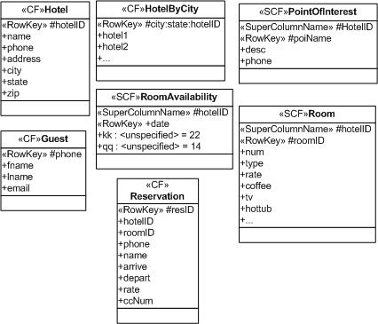
CASSANDRA

Slide 38
When is Cassandra a great fit ?
Writes exceed reads by a large margin.
Data is rarely updated and when updates are made they are idempotent.
Read Access is by a known primary key.
Data can be partitioned via a key that allows the database to be spread evenly across multiple nodes.
There is no need for joins or aggregates.

Slide 39
When is Cassandra not a Good fit?
Tables have multiple access paths. Example: lots of secondary indexes.
Cassandra does not do ACID. LSD, Sulphuric or any other kind.
Aggregates
Joins
Updates
Transactions

Slide 40
Cassandra Use Cases
Transaction logging: Purchases, test scores, movies watched and movie latest location.
Storing time series data (as long as you do your own aggregates).
Tracking pretty much anything including order status, packages, inventory, supply chain etc.
GeoSpatial Data, Survey Data.
Weather service history.
Internet of things status and event history.
Telematics: IOT for cars and trucks.

